Slide 1
AngularJS SPA JumpStart
Dan Wahlin

Slide 2



Dan Wahlin
Blog
http://weblogs.asp.net/dwahlin
Twitter
@DanWahlin

Slide 3

http://angularjs.org

Slide 4

Notes:
First time I looked at it I felt like it was a little strange….but I could go with it.

Slide 5

Notes:
As I researched more I came across some things that looked really strange and just didn't click with me.

Slide 6

Transclusion
?
Restriction
Scope
Directive
Linking
Notes:
I saw a lot of words that were confusing and after more research I started to get a little frustrated…kind of felt like this kid.

Slide 7

Notes:
But, I stuck with it, kept on researching and playing around with the samples, took a deep breath and….

Slide 8

Notes:
I chilled out, and once a few things started to click I started to realize that I could really take advantage of some great features!

Slide 9

Notes:
Once you have that "light bulb moment" you realize how powerful and flexible AngularJS is. That's when it truly changes how you think about writing Single Page Applications (SPAs) and client-side applications in general.

Slide 10

Notes:
And then at some point it hit me – this framework is really powerful!

Slide 11

Agenda
AngularJS Features
Getting Started
Directives, Filters and Data Binding
Views, Controllers and Scope
Modules, Routes and Factories

Slide 12
Getting Started

Slide 13





Single Page Application (SPA)
SPA Demo
http://www.myspa.com
View
View
View
View

Slide 14

The Challenge with SPAs
DOM Manipulation
History
Module Loading
Routing
Caching
Object Modeling
Data Binding
Ajax/Promises
View Loading

Slide 15



Slide 16
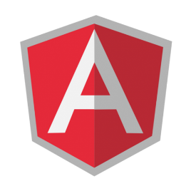
Data Binding
MVC
Routing
Testing
jqLite
Templates
History
Factories
ngularJS is a full-featured SPA framework
ViewModel
Controllers
Views
Directives
Controllers
Dependency Injection
Validation

Slide 17
Directives, Filters
and Data Binding

Slide 18
What are Directives?
They teach HTML new tricks!

Slide 19
Using Directives and Data Binding
<!DOCTYPE html>
<html ng-app>
<head>
<title></title>
</head>
<body>
<div class="container">
Name: <input type="text" ng-model="name" /> {{ name }}
</div>
<script src="Scripts/angular.js"></script>
</body>
</html>
Directive
Directive
Data Binding Expression

Slide 20
Iterating with the ng-repeat Directive
<html data-ng-app="">
...
<div class="container" data-ng-init="names=['Dave','Napur','Heedy','Shriva']">
<h3>Looping with the ng-repeat Directive</h3>
<ul>
<li data-ng-repeat="name in names">{{ name }}</li>
</ul>
</div>
...
</html>
Iterate through names

Slide 21
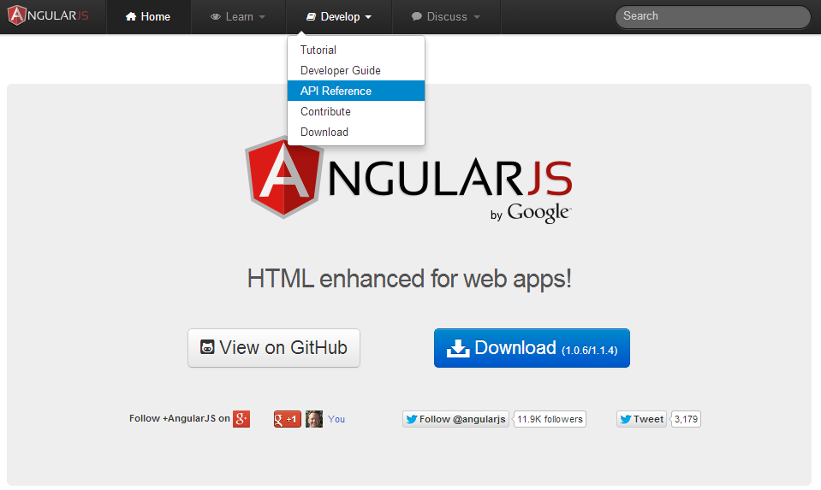
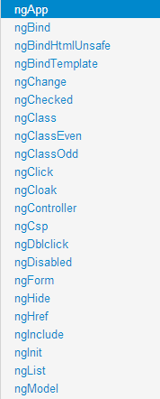
AngularJS Help for Directives

Slide 22
Using Filters
<ul>
<li data-ng-repeat="cust in customers | orderBy:'name'"> {{ cust.name | uppercase }} </li>
</ul>
Order customers by name property
Filter customers by model value
<input type="text" data-ng-model="nameText" />
<ul>
<li data-ng-repeat="cust in customers | filter:nameText | orderBy:'name'"> {{ cust.name }} - {{ cust.city }}</li>
</ul>

Slide 23
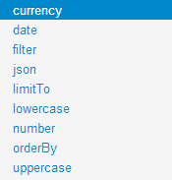
AngularJS Help for Filters

Slide 24

Demo

Slide 25
Views, Controllers
and Scope

Slide 26
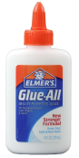
View, Controllers and Scope
$scope
View
Controller
$scope is the "glue" (ViewModel) between a controller and a view

Slide 27
Creating a View and Controller
<div class="container" data-ng-controller="SimpleController">
<h3>Adding a Simple Controller</h3>
<ul>
<li data-ng-repeat="cust in customers"> {{ cust.name }} - {{ cust.city }} </li>
</ul>
</div>
<script>
function SimpleController($scope) { $scope.customers = [
{ name: 'Dave Jones', city: 'Phoenix' },
{ name: 'Jamie Riley', city: 'Atlanta' },
{ name: 'Heedy Wahlin', city: 'Chandler' },
{ name: 'Thomas Winter', city: 'Seattle' }
];
}
</script>
Define the controller to use
Access $scope
$scope injected dynamically
Basic controller

Slide 28
Demo

Slide 29
Modules, Routes
and Factories

Slide 30
Module
Config
Routes
View
$scope
Controller
Directives
*Factory

Slide 31
Modules are Containers
<html ng-app="moduleName">
Module
Config
Filter
Directive
Factory
Controller
Service
Routes
Provider
Value

Slide 32
Creating a Module
What's the Array for?
var demoApp = angular.module('demoApp', []);
var demoApp = angular.module('demoApp',
['helperModule']);
Module that demoApp depends on

Slide 33
Creating a Controller in a Module
var demoApp = angular.module('demoApp', []);
demoApp.controller('SimpleController', function ($scope) {
$scope.customers = [
{ name: 'Dave Jones', city: 'Phoenix' },
{ name: 'Jamie Riley', city: 'Atlanta' },
{ name: 'Heedy Wahlin', city: 'Chandler' },
{ name: 'Thomas Winter', city: 'Seattle' }
];
});
Define a Module
Define a Controller

Slide 34
The Role of Routes
SPA Demo
http://www.myspa.com
View1
/view2
View2
/view3
/view1
View4
/view4
View3

Slide 35
Defining Routes
var demoApp = angular.module('demoApp', ['ngRoute']);
demoApp.config(function ($routeProvider) {
$routeProvider
.when('/',
{
controller: 'SimpleController',
templateUrl:'View1.html'
})
.when('/view2',
{
controller: 'SimpleController',
templateUrl:'View2.html'
})
.otherwise({ redirectTo: '/' });
});
Define Module Routes

Slide 36
Where do Views Go in a Page?
Dynamically loaded views are injected into the shell page as a module loads:
SPA Demo
http://www.myspa.com
<div ng-view></div>
View1
OR
<ng-view></ng-view>

Slide 37
The Role of Factories
var demoApp = angular.module('demoApp', [])
.factory('simpleFactory', function () {
var factory = {};
var customers = [ ... ];
factory.getCustomers = function () {
return customers;
};
return factory;
})
.controller('SimpleController', function ($scope, simpleFactory) {
$scope.customers = simpleFactory.getCustomers();
});
Factory injected into controller at runtime

Slide 38
Module
Config
Routes
View
$scope
Controller
Directives
*Factory

Slide 39
Summary
AngularJS provides a robust "SPA" framework for building robust client-centric applications
Key features:
Directives and filters
Two-way data binding
Views, Controllers, Scope
Modules and Routes

Slide 41
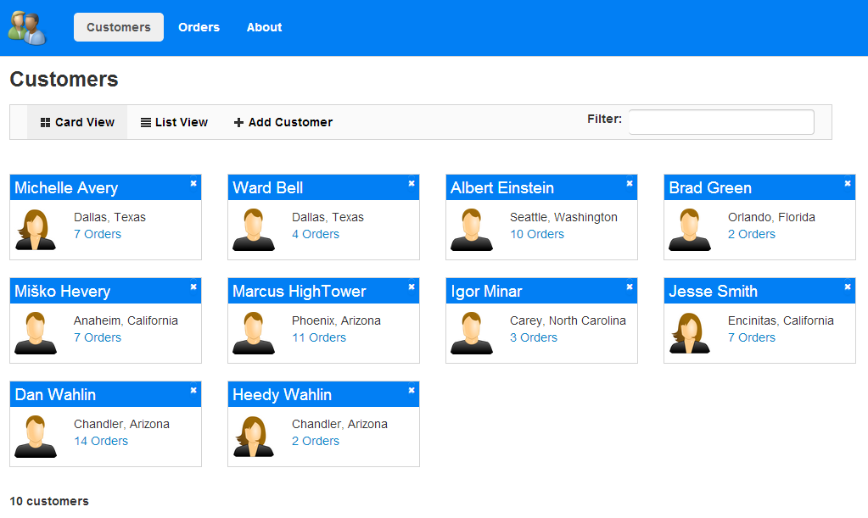
Sample Code
http://tinyurl.com/AngularJSDemos
http://tinyurl.com/CustomerMgr

